Slide 1
Domain participation during annual meeting (instructions)
On Thursday, 16 Sep 21 during the 1:05 - 1:50 PM timeslot, each domain will be called on to provide a summary of their 2021 highlights and 2022 objectives. Expect about 5 – 7 minutes for each domain. A template is attached (next slide) for your convenience.
Please complete the template and return it to Steve Sullivan ​no later than 2 September. You may include additional slides as you see fit.
If you have questions, please contact:
Kamran Atri - katri@A4SAFE.COM
Thomas Krul - thomas.krul@forces.gc.ca , thomas_krul@hotmail.com , thomas.krul@ecn.forces.gc.ca
Steve Sullivan - stephen.m.sullivan14.ctr@mail.mil

Slide 2
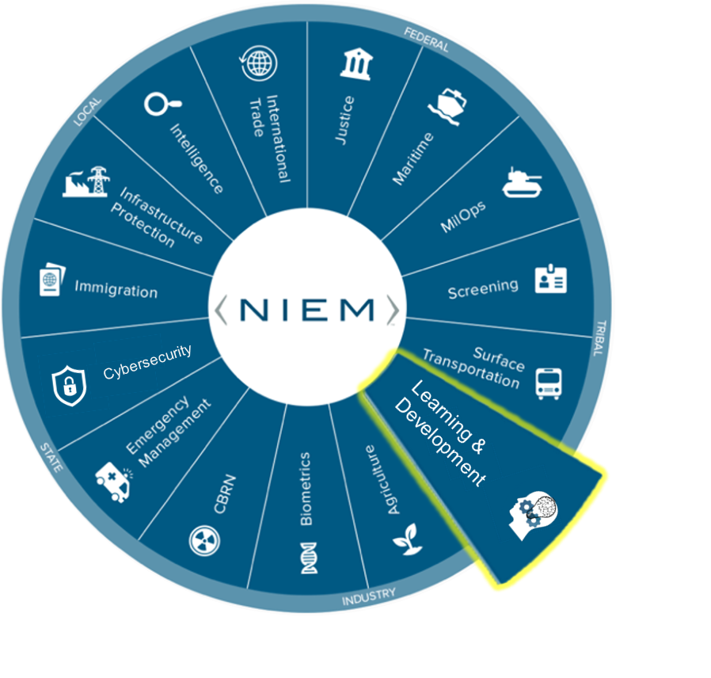

NBAC Annual Meeting
LEARNING & DEVELOPMENT
DOMAIN UPDATES
www/sdlnet.gov

Slide 3

Learning and Development Domain Update
Domain Steward & Stakeholders: (Insert Personnel Names & Organizations Here)
Description
2021 Highlights: Describe your NIEM domain accomplishments, activities, best practices 2022 Objectives: Describe your NIEM domain goals and plans for next year NIEM Recommendations: Describe how NIEM should evolve to the “next level”
2021 Highlights
2022 Objectives
NIEM Recommendations
Insert Bullets Here
Insert Bullets Here
Insert Bullets Here

